Slide 1
Cinema-Dining Terrace Expansion
Suburbia, USA
Image Courtesy of The Whiting-Turner Contracting Company
Penn State AE Senior Capstone Project
Nicholas J. Kline | Construction Option
Advisor | Mr. Ray Sowers

Slide 2
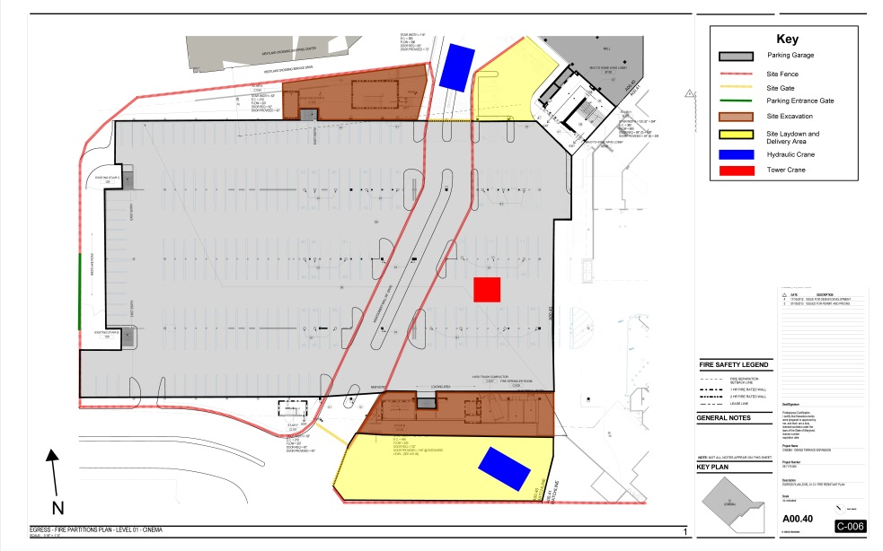
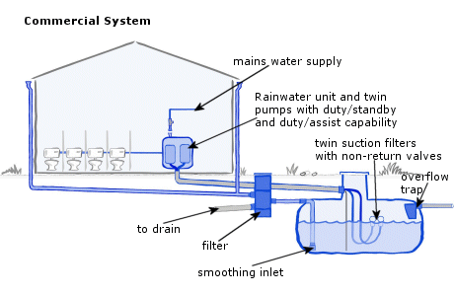
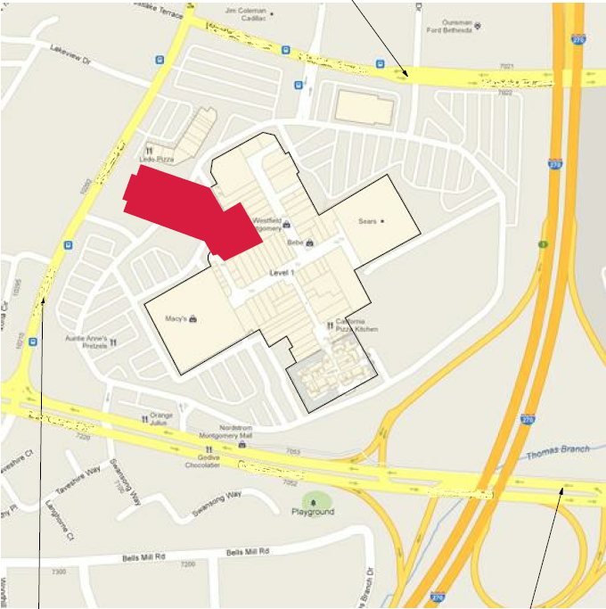
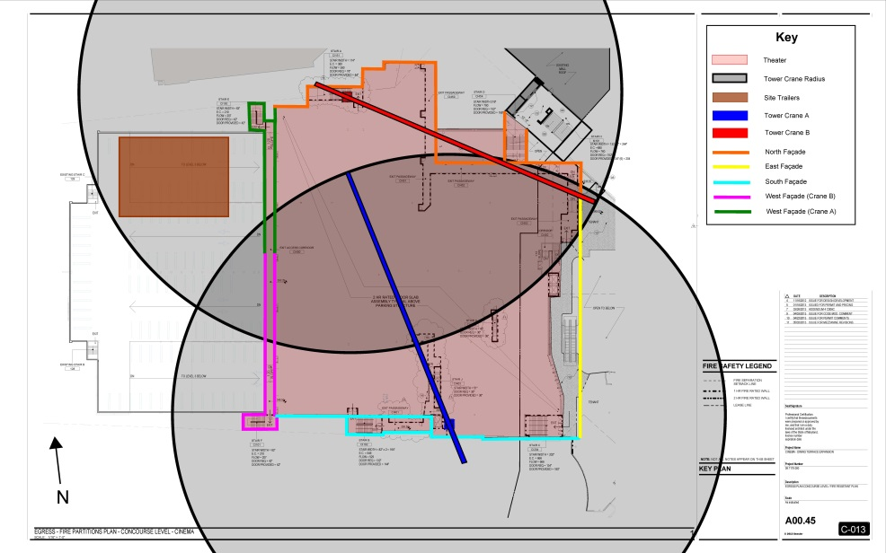
Introduction
Introduction
Project Background
Analysis 1 | Site Logistics Analysis
Analysis 2 | Exterior Envelope Prefabrication
Analysis 3 | Water Drainage Recycling
Conclusions and Recommendations
Acknowledgements
Analysis 3 | Water Drainage Recycling
Analysis 1 | Site Logistics
Project Background
Analysis 2 | Prefabrication of Exterior Envelope
Courtesy of www.gslplumbers.com
Courtesy of Whiting-Turner

Slide 3
Project Background
Introduction
Project Background
Analysis 1 | Site Logistics Analysis
Analysis 2 | Exterior Envelope Prefabrication
Analysis 3 | Water Drainage Recycling
Conclusions and Recommendations
Acknowledgements
Building Name | Cinema-Dining Terrace Expansion
Location | Suburbia, USA
Building Occupant | ArchLight Cinema
Building Functions | Covered Mall Building Assembly, Business, Mercantile, Storage
Size | 91,000 GSF 70,000 sqft 16 Screen Cinema 12,000 sqft Food Court Expansion 9,500 sqft Restaurants
Number of Stories | 3 stories above grade
Project Timeline | June 2012 – August 2014
Cost | $50,223,763.00
Owner | Anonymous Owner
GC | The Whiting-Turner Contracting Company
Architect | Gensler
Structural Engineer | Robert Silman Associates
MEP Engineer | B&R Construction Services
Image Courtesy of The Whiting-Turner Contracting Company

Slide 4
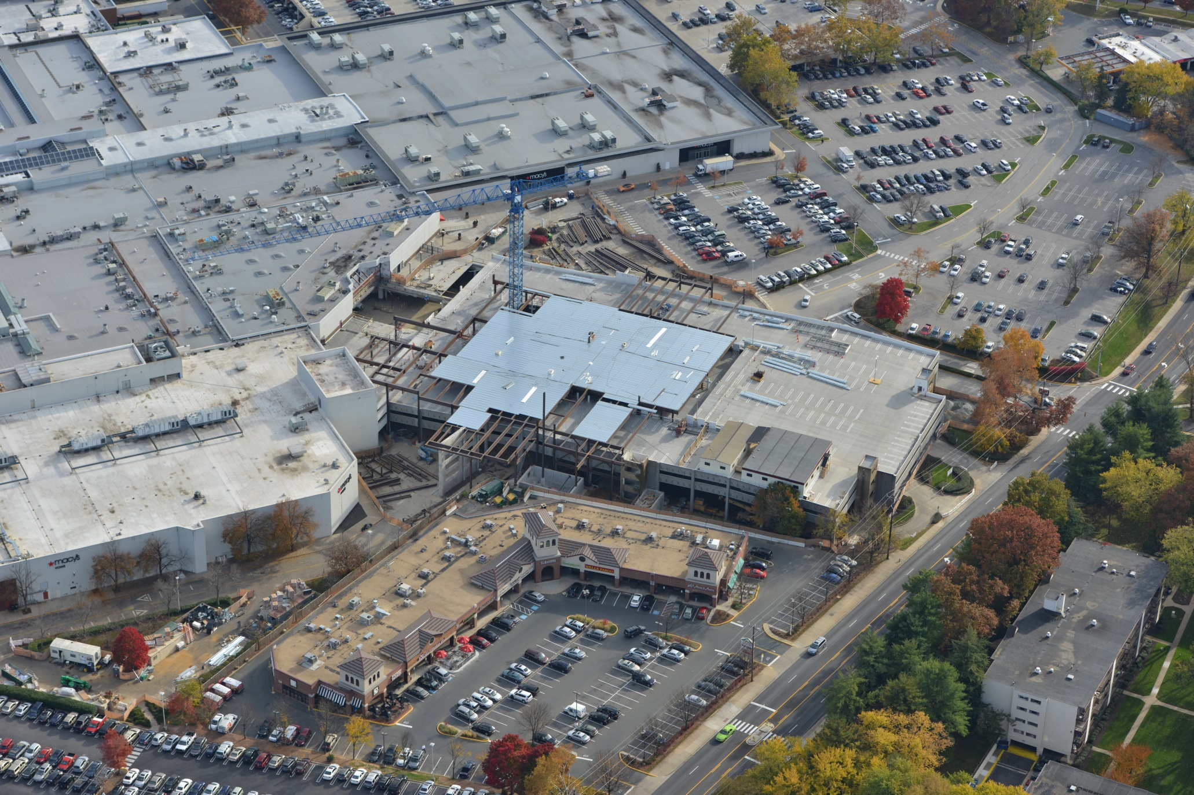
Project Background
Introduction
Project Background
Analysis 1 | Site Logistics Analysis
Analysis 2 | Exterior Envelope Prefabrication
Analysis 3 | Water Drainage Recycling
Conclusions and Recommendations
Acknowledgements
Building Systems
Structural System
Foundation - Micro-piles with pile caps, sandwich footings, spread footings, and mat slabs
Structural Steel
Exterior Enclosure System
EIFS Storefront Glazing
Metal Panels
Image Courtesy of The Whiting-Turner Contracting Company

Slide 5
Analysis 1 | Site Logistics Analysis
Introduction
Project Background
Analysis 1 | Site Logistics Analysis
Analysis 2 | Exterior Envelope Prefabrication
Analysis 3 | Water Drainage Recycling
Conclusions and Recommendations
Acknowledgements
Opportunity:
The current site logistics requires extensive means and methods adding to the critical schedule.

Slide 6
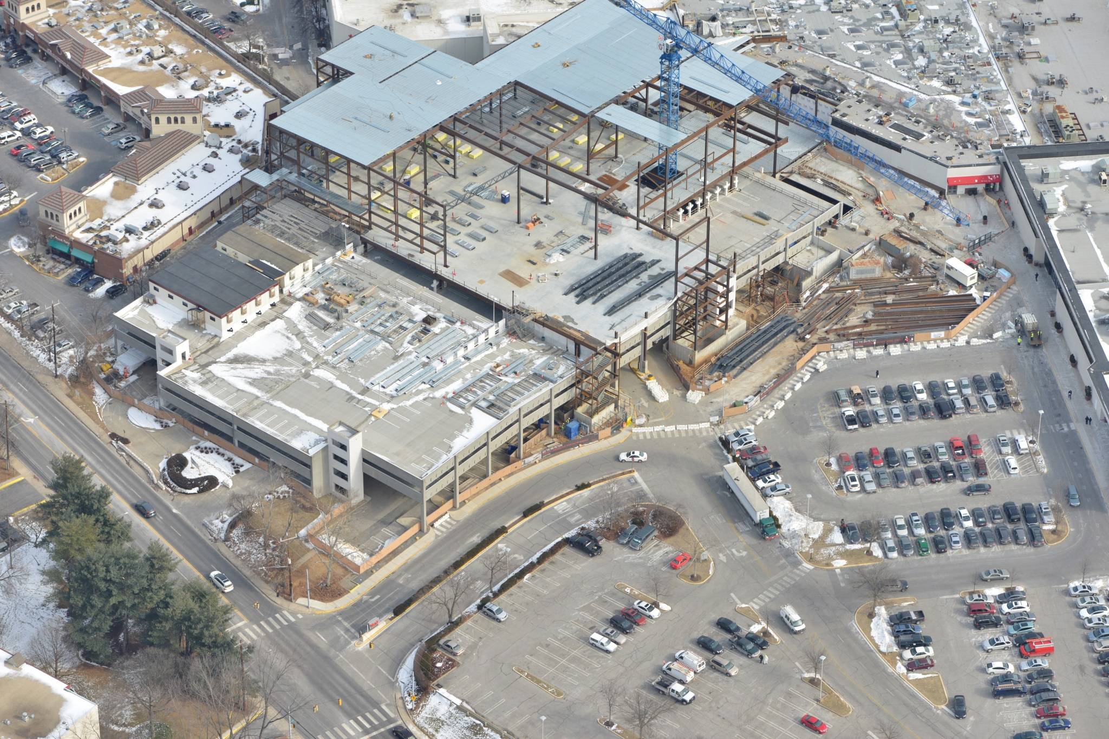
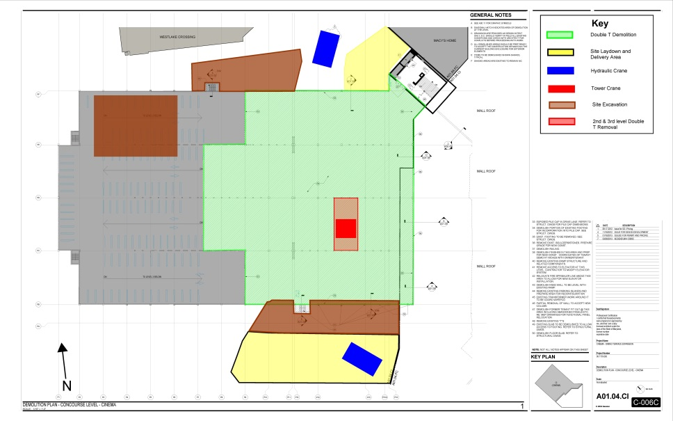
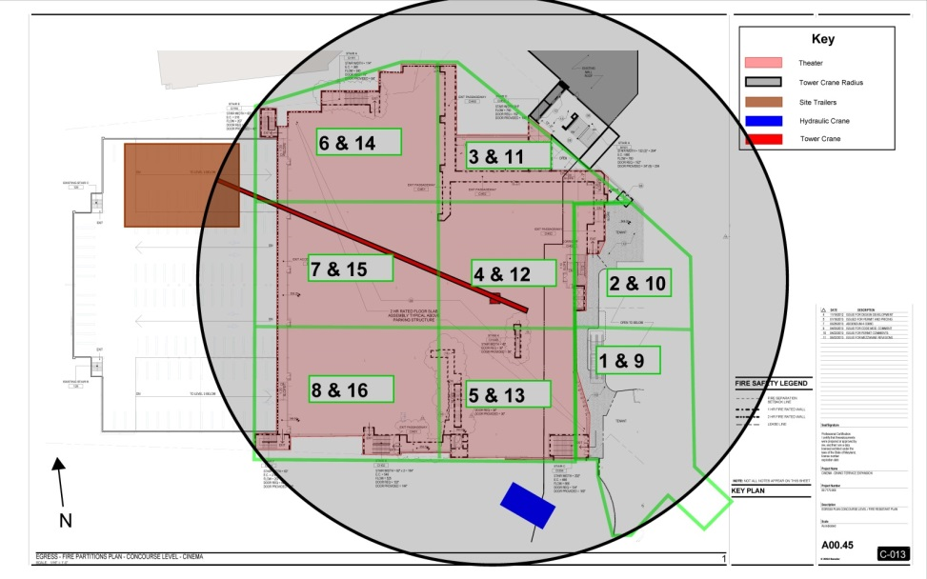
Current Site Logistics
Introduction
Project Background
Analysis 1 | Site Logistics Analysis
Overview of Site Logistics
Structural Breadth
Cost and Schedule
Analysis 2 | Exterior Envelope Prefabrication
Analysis 3 | Water Drainage Recycling
Conclusions and Recommendations
Acknowledgements
Demolition Phase
Steel Erection Phase
Image Courtesy of The Whiting-Turner Contracting Company

Slide 7
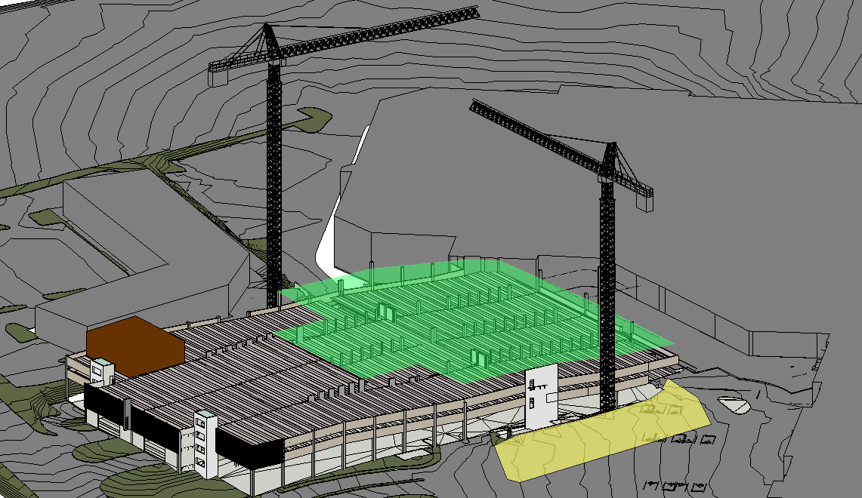
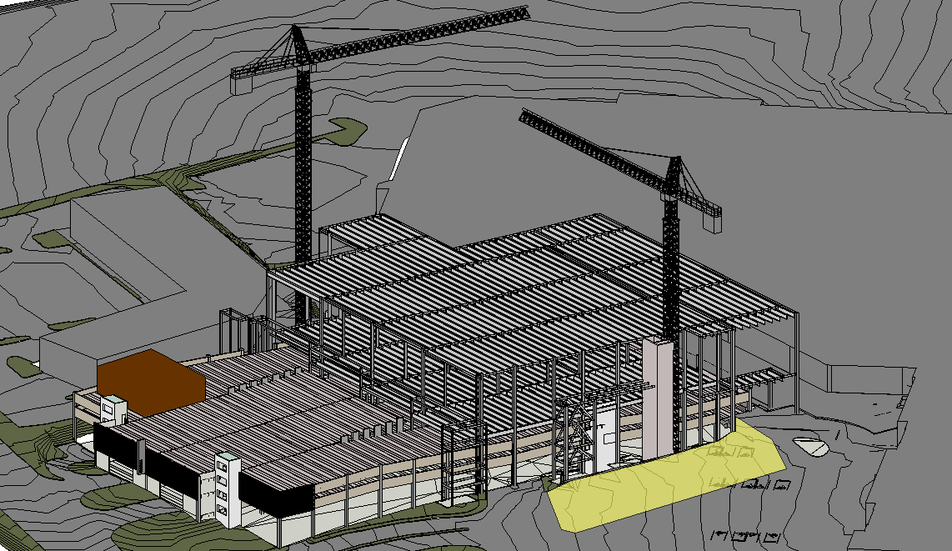
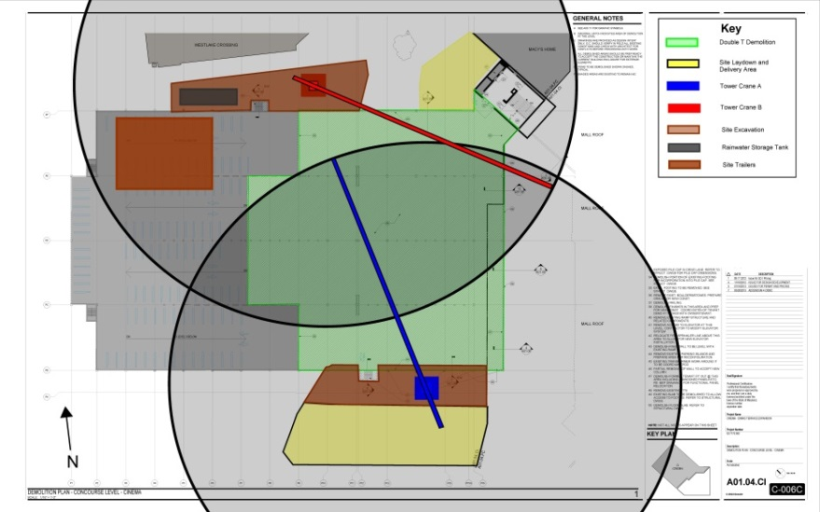
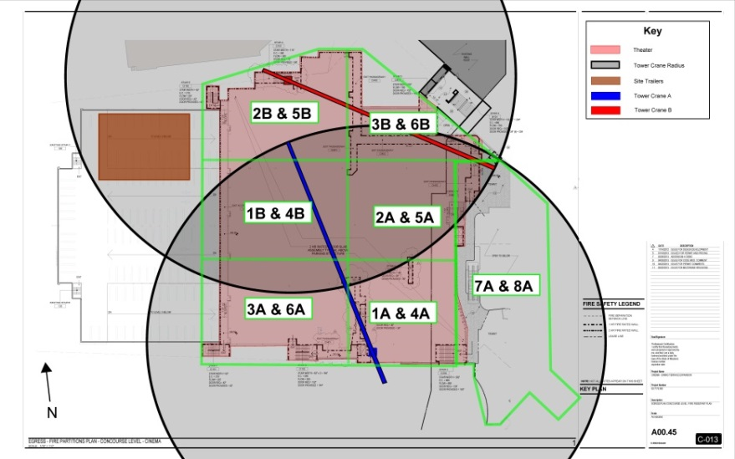
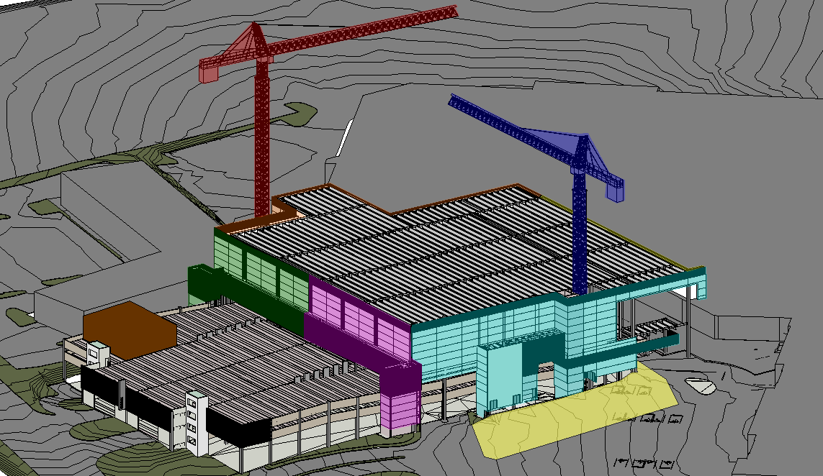

New Site Logistics
Introduction
Project Background
Analysis 1 | Site Logistics Analysis
Overview of Site Logistics
Structural Breadth
Cost and Schedule
Analysis 2 | Exterior Envelope Prefabrication
Analysis 3 | Water Drainage Recycling
Conclusions and Recommendations
Acknowledgements
New Site Phasing
Demolition Phase
Steel Erection Phase
Exterior Envelope Phase

Slide 8
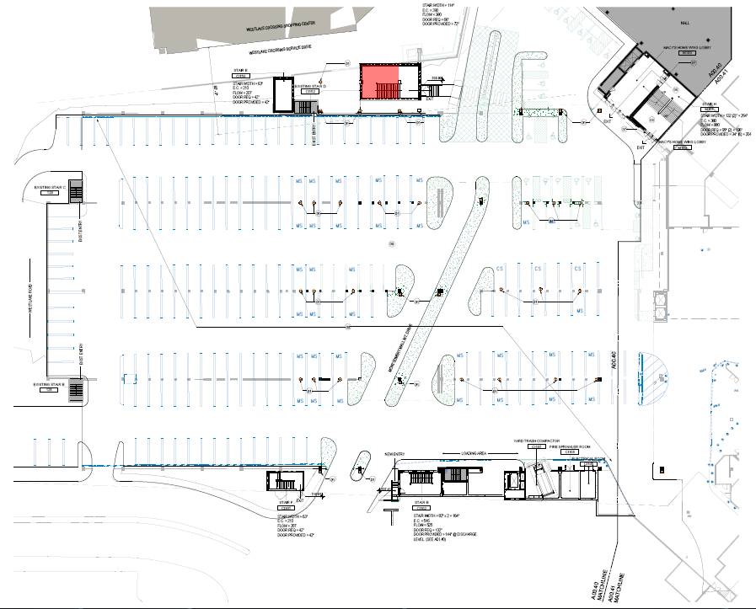
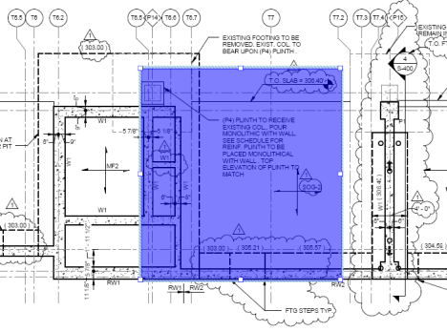
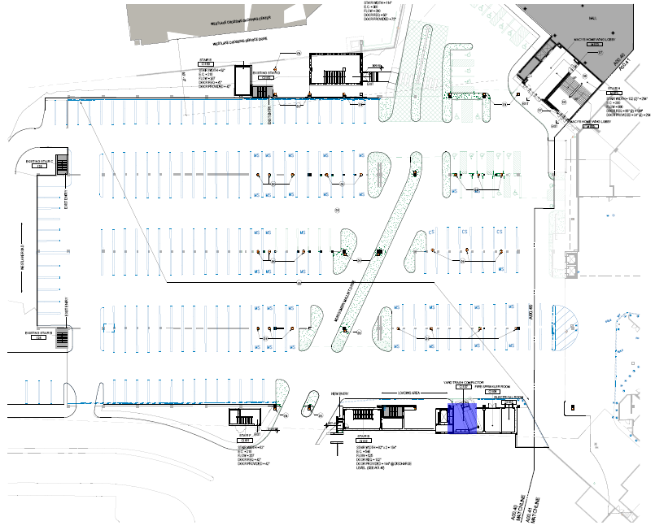
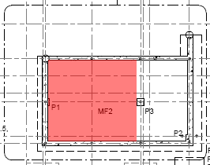
Structural Breadth
Introduction
Project Background
Analysis 1 | Site Logistics Analysis
Overview of Site Logistics
Structural Breadth
Cost and Schedule
Analysis 2 | Exterior Envelope Prefabrication
Analysis 3 | Water Drainage Recycling
Conclusions and Recommendations
Acknowledgements
Tower Crane A Foundation
Tower Crane B Foundation

Slide 9
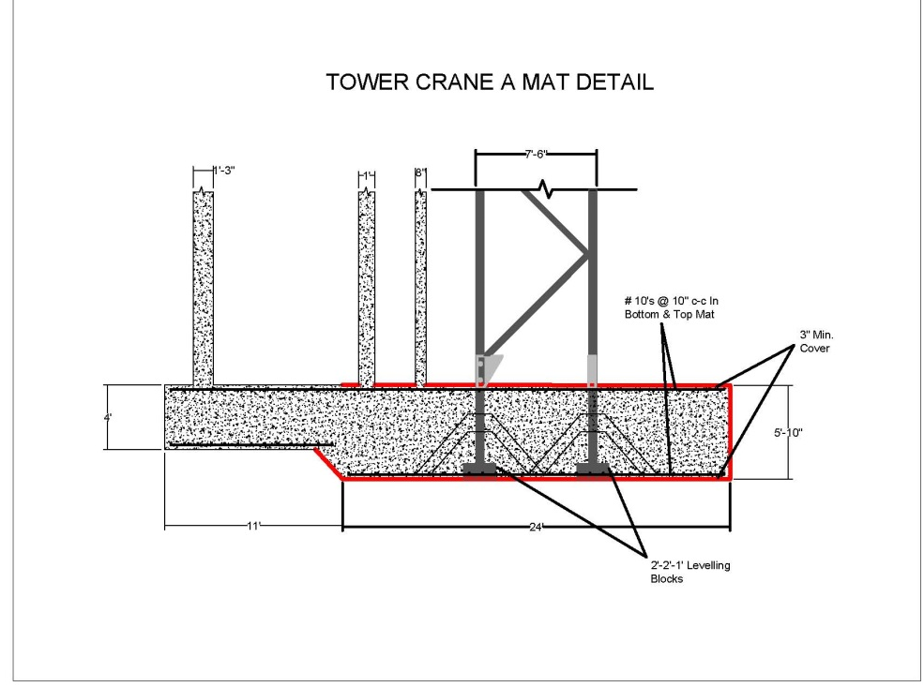
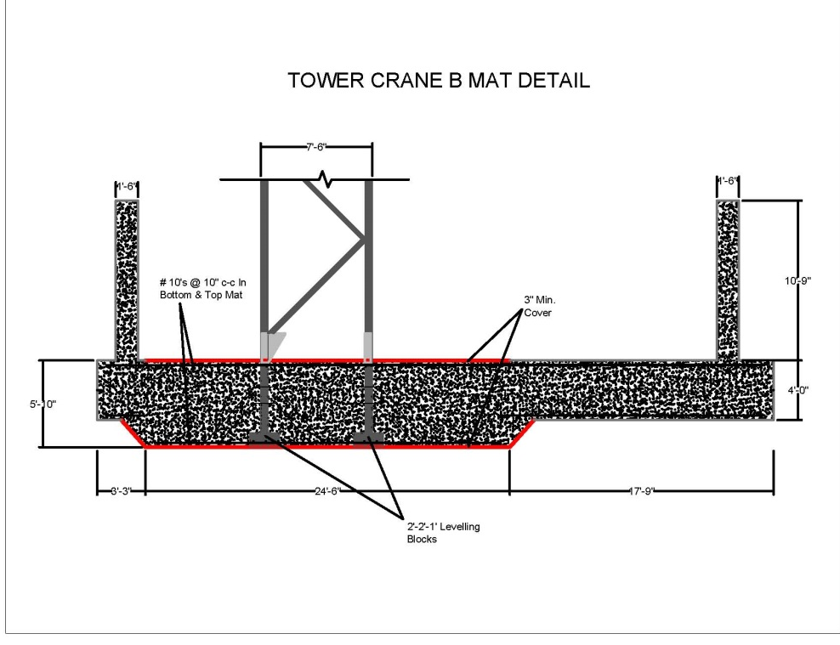
Structural Breadth
Introduction
Project Background
Analysis 1 | Site Logistics Analysis
Overview of Site Logistics
Structural Breadth
Cost and Schedule
Analysis 2 | Exterior Envelope Prefabrication
Analysis 3 | Water Drainage Recycling
Conclusions and Recommendations
Acknowledgements
Tower Crane A
Tower Crane B
Tower Crane Specifications
Model: Linden Comansa 21LC550
Hook Height: 136.8 ft
Jib Reach: 262.4 ft
Tower Crane Specifications
Model: Linden Comansa 21LC550
Hook Height: 172.9 ft
Jib Reach: 262.4 ft

Slide 10
Schedules
Introduction
Project Background
Analysis 1 | Site Logistics Analysis
Overview of Site Logistics
Structural Breadth
Cost and Schedule
Analysis 2 | Exterior Envelope Prefabrication
Analysis 3 | Water Drainage Recycling
Conclusions and Recommendations
Acknowledgements
Original Site Logistics Schedule
New Site Logistics Schedule
New Duration | 497 Days
Savings | 41 workdays
57 total days
Original Duration | 538 Days

Slide 11
Costs
Introduction
Project Background
Analysis 1 | Site Logistics Analysis
Overview of Site Logistics
Structural Breadth
Cost and Schedule
Analysis 2 | Exterior Envelope Prefabrication
Analysis 3 | Water Drainage Recycling
Conclusions and Recommendations
Acknowledgements
Original Site logistics Costs
New Site logistics Costs
Savings | $533,398.00
Additional Savings | $500,000.00/month = $1,000,000.00
Total Estimated Savings | $1,533,398.00

Slide 12
Analysis 2 | Exterior Envelope Prefab
Introduction
Project Background
Analysis 1 | Site Logistics Analysis
Analysis 2 | Exterior Envelope Prefabrication
Analysis 3 | Water Drainage Recycling
Conclusions and Recommendations
Acknowledgements
Opportunity:
Stick building the exterior envelope is time consuming and labor intensive.

Slide 13
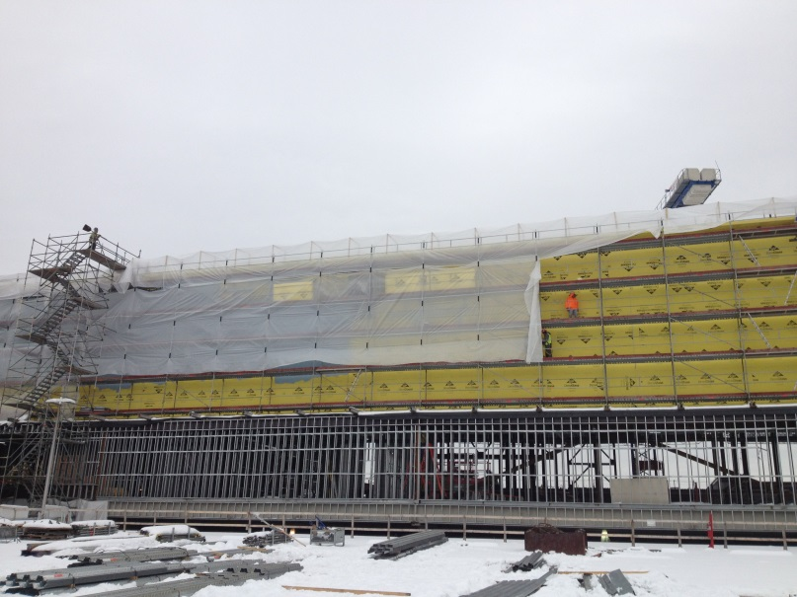
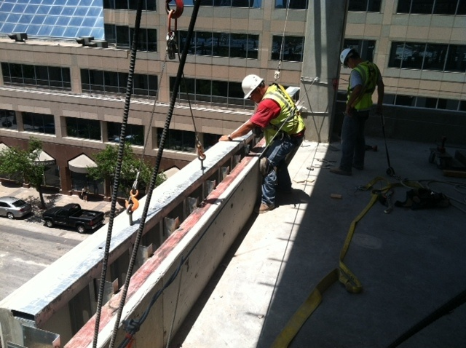
Analysis 2 | Exterior Envelope Prefab
Introduction
Project Background
Analysis 1 | Site Logistics Analysis
Analysis 2 | Exterior Envelope Prefabrication
Overview of Curtain Wall
Cost and Schedule
Analysis 3 | Water Drainage Recycling
Conclusions and Recommendations
Acknowledgements
Original | Stick Built
Redesign | Prefabrication
Laborers | 8
Duration | 120 days
Laborers | 2
Equipment | Tower Crane
Duration | 37 days
Materials:
EIFS
Framing and Sheathing
Materials:
EIFS Panels
Framing and Sheathing Panels
Image Courtesy of The Whiting-Turner Contracting Company
Image Courtesy of KHS&S

Slide 14

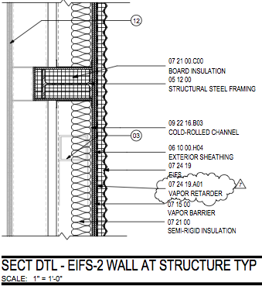
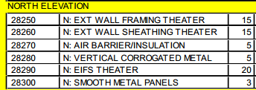
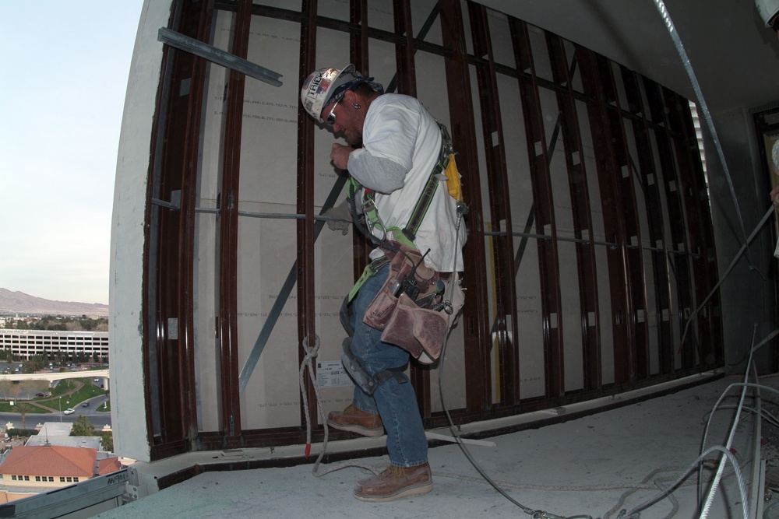
Analysis 2 | Exterior Envelope Prefab
Introduction
Project Background
Analysis 1 | Site Logistics Analysis
Analysis 2 | Exterior Envelope Prefabrication
Overview of Curtain Wall
Cost and Schedule
Analysis 3 | Water Drainage Recycling
Conclusions and Recommendations
Acknowledgements
Original Exterior
New Site Exterior
Largest Dryvit installer in the US
EIFS Panels | finish, framing, sheathing, air barrier, and insulation
Accelerates enclosing the building
Fabrication is done to exact specifications
Fabrication is done in a controlled environment
Panels are delivered ready to install
Image Courtesy of KHS&S

Slide 15
Schedules
Introduction
Project Background
Analysis 1 | Site Logistics Analysis
Overview of Curtain Wall
Cost and Schedule
Analysis 3 | Water Drainage Recycling
Conclusions and Recommendations
Acknowledgements
Analysis 2 | Exterior Envelope Prefabrication
Original Exterior Installation Schedule
New Exterior Installation Schedule
Workdays | 122 days
Duration | 133 days
(8-Jul-13 to 13-Jan-14)
Workdays | 37 days
Duration | 72 days (12-Aug-13 to 17-Jun-13)

Slide 16
Costs
Introduction
Project Background
Analysis 1 | Site Logistics Analysis
Analysis 2 | Exterior Envelope Prefabrication
Overview of Curtain Wall
Cost and Schedule
Analysis 3 | Water Drainage Recycling
Conclusions and Recommendations
Acknowledgements
Original Exterior Costs
New Exterior Costs
Exterior Metal Studs & Sheathing Panels | $35.00/SF
EIFS Panels | $45.00/SF
Total New Cost | $2,857,955.00

Slide 17
Analysis 3 | Water Drainage Recycling
Introduction
Project Background
Analysis 1 | Site Logistics Analysis
Analysis 2 | Exterior Envelope Prefabrication
Analysis 3 | Water Drainage Recycling
Conclusions and Recommendations
Acknowledgements
Overview of System
Mechanical Breadth
Costs
Opportunity:
Rainwater recycling can add sustainability and cost savings to the project.

Slide 18
Analysis 3 | Water Drainage Recycling
Introduction
Project Background
Analysis 1 | Site Logistics Analysis
Analysis 2 | Exterior Envelope Prefabrication
Analysis 3 | Water Drainage Recycling
Conclusions and Recommendations
Acknowledgements
Overview of System
Mechanical Breadth
Costs
Rainwater Recycling
Basic Commercial Rainwater Recycling System
Free source of non-potable water
Primary use | Toilet and Urinal Fixtures
Equipment | Storage Tank with Accessories, Filtration system, pump system, and added piping
Large Flat Roof
Courtesy of www.gslplumbers.com

Slide 19
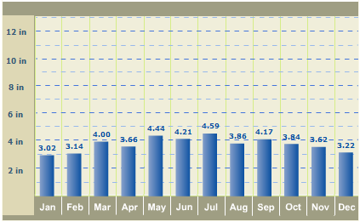
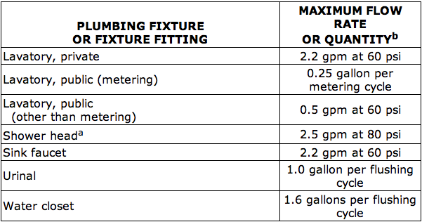


Mechanical Breadth
Introduction
Project Background
Analysis 1 | Site Logistics Analysis
Analysis 2 | Exterior Envelope Prefabrication
Analysis 3 | Water Drainage Recycling
Conclusions and Recommendations
Acknowledgements
Overview of System
Mechanical Breadth
Cost
Rainwater Supply
Water Demand
Courtesy of www.weather.com
Courtesy of the International Plumbing Code
Roof | 86,640 SF Monthly Avg. (in.) | 3.81
CF to Gallon Factor | 7.48 CF/G
$$86,64∗\left(\frac{3.81}{12}\right)∗\left(.9\right)∗7.48=185,185.2 Gallons per month=2,222,222.4 Gallons per year$$
Toilets | 120 flushes per day Urinals | 75 flushes per day
Toilets | 1.6 gallons per flush Urinals | 1.0 gallon per flush
$$\left(46∗120∗1.6\right)+\left(10∗75∗1.0\right)=9,582 Gallons per day=239,550 Gallons per month$$
$$=2,874,600 Gallons per year$$

Slide 20
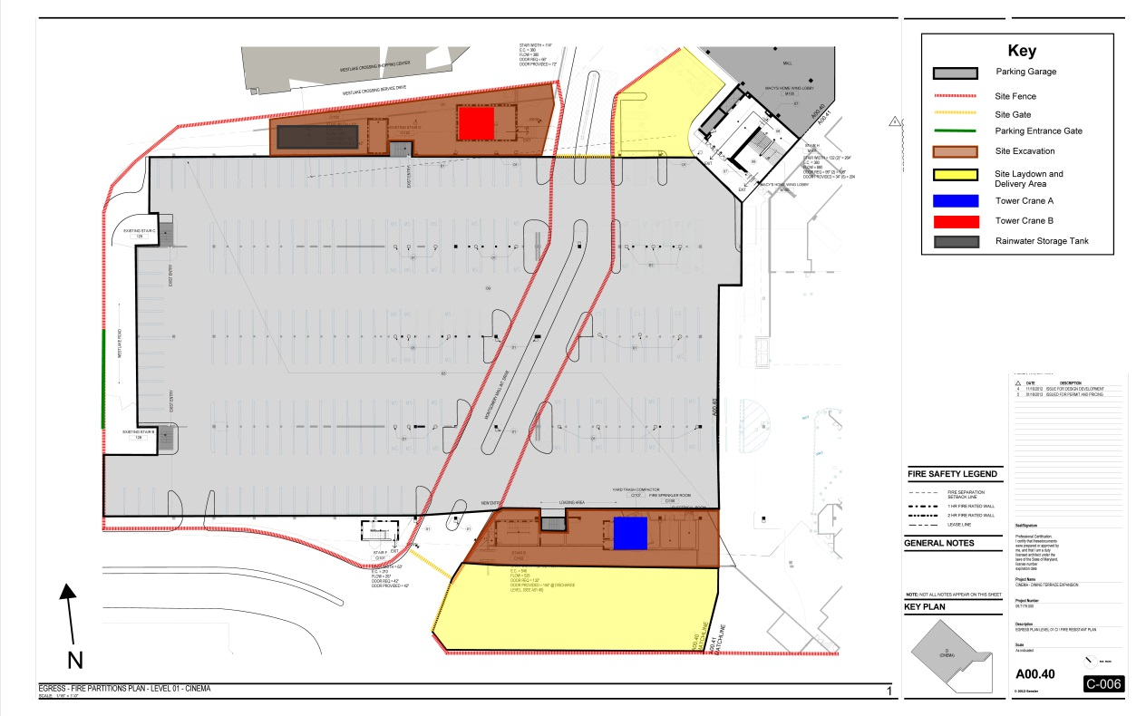
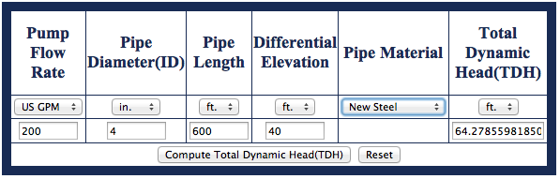
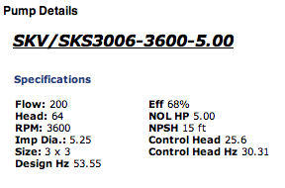
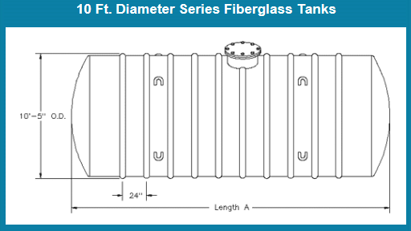
Mechanical Breadth
Introduction
Project Background
Analysis 1 | Site Logistics Analysis
Analysis 2 | Exterior Envelope Prefabrication
Analysis 3 | Water Drainage Recycling
Conclusions and Recommendations
Acknowledgements
Overview of System
Mechanical Breadth
Costs
Pump
Storage Tank
Total Dynamic Head Calculator
Size | 20,000 gal
Length | 35’ 0”
Diameter | 10’ 0”
Courtesy of www.pumpworld.com
Pump | 5 HP Selfsensing Variable Speed Pump
Courtesy of www.darcoinc.com
Courtesy of www.taco-hvac.com

Slide 21
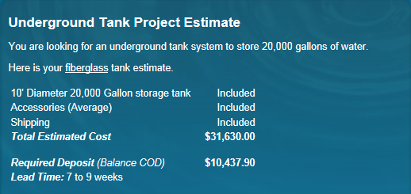
Costs
Introduction
Project Background
Analysis 1 | Site Logistics Analysis
Analysis 2 | Exterior Envelope Prefabrication
Analysis 3 | Water Drainage Recycling
Conclusions and Recommendations
Acknowledgements
Overview of System
Mechanical Breadth
Costs
Equipment Costs
Water Costs
Domestic Water Annual Demand | ($6.76/1000G) * 2,874,600G = $19,432.29
Annual Water Savings | ($6.76/1000G) * 2,222,222.4G = $15,022.22
Total Annual Cost | $19,432.29 - $15,022.22 = $4,410.07
7 year system payback period
Courtesy of www.darcoinc.com
Estimated new piping | $50,000
Estimated total system costs | $81,630.00

Slide 22
Conclusions
Introduction
Project Background
Analysis 1 | Site Logistics Analysis
Analysis 2 | Exterior Envelope Prefabrication
Analysis 3 | Water Drainage Recycling
Conclusions and Recommendations
Acknowledgements
Analysis 1 | Site Logistics Analysis
Analysis 2 | Exterior Envelope Prefabrication
Total Original Costs | $1,848,390.00
Total New Costs | $1,314,992.00
Total Savings | $533,398.00
Estimated Owner Savings | $1,000,000.00
Original Costs | ~ $2,453,353.00
Prefabricated Costs | ~ $3,191,843.00
Total Added Costs | $738,490.00
Original Schedule| 122 workdays
Prefabricated Schedule| 37 workdays
Total Savings | 85 workdays
Original Schedule Duration | 538 workdays
New Schedule Duration | 497 workdays
Total Savings | 41 workdays or about 2 months
Estimated Owner Savings | $500,000.00/month
Analysis 3 | Water Drainage Recycling
System Costs | ~ $80,000
7 year payback period
Water Cost Savings | ~ $15,000/year

Slide 23
Recommendations
Introduction
Project Background
Analysis 1 | Site Logistics Analysis
Analysis 2 | Exterior Envelope Prefabrication
Analysis 3 | Water Drainage Recycling
Conclusions and Recommendations
Acknowledgements
Analysis 1 | Site Logistics Analysis
Yes recommended | Benefits to both cost and schedule
Analysis 2 | Exterior Envelope Prefabrication
Not recommended | Costs outweigh schedule improvements
Analysis 3 | Water Drainage Recycling
Yes recommended | Water Cost Savings

Slide 24


Acknowledgements
Introduction
Project Background
Analysis 1 | Site Logistics Analysis
Analysis 2 | Exterior Envelope Prefabrication
Analysis 3 | Water Drainage Recycling
Conclusions and Recommendations
Acknowledgements
Academic Acknowledgements
Mr. Ray Sowers | CM Faculty Advisor
Prof. Kevin Parfitt
Prof. Charles Cox
Prof. Moses Ling
Penn State AE Faculty
Special Thanks
The Whiting-Turner Project Team
My Family and Friends

Slide 25
Questions?

Slide 26
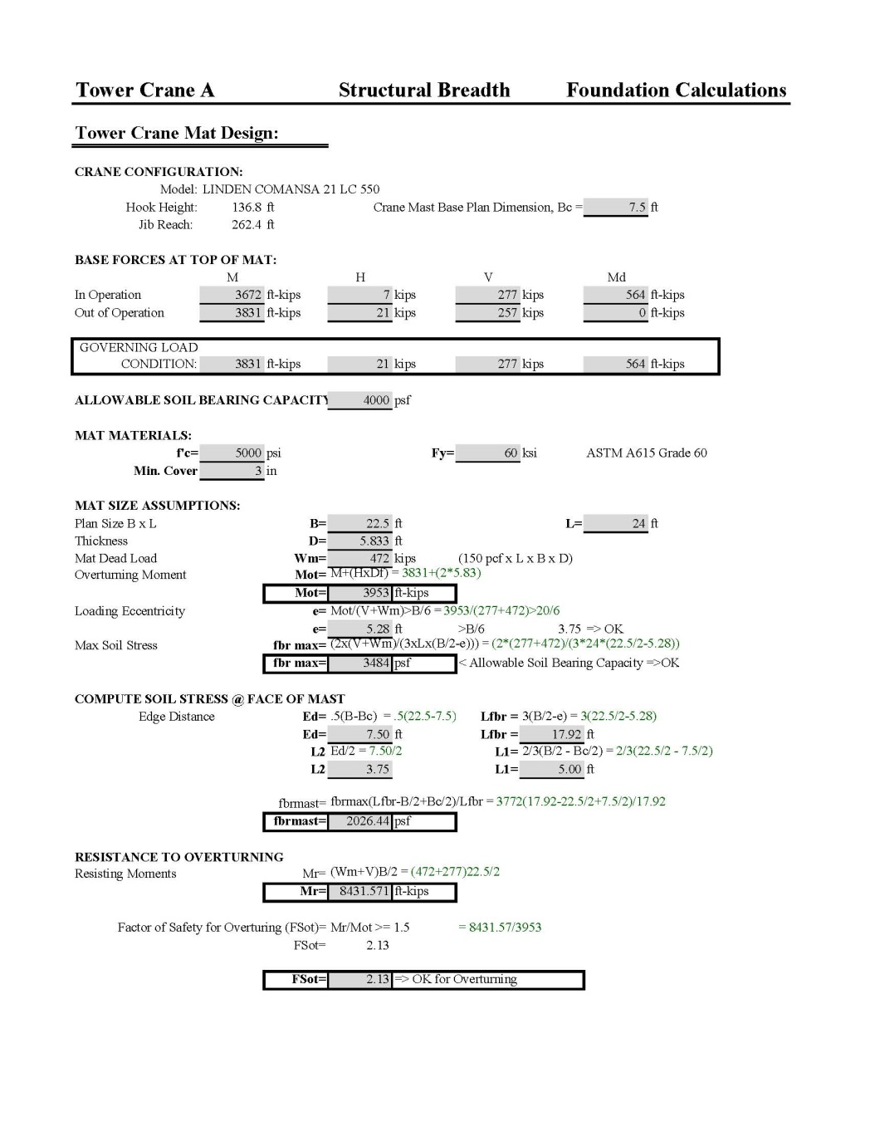
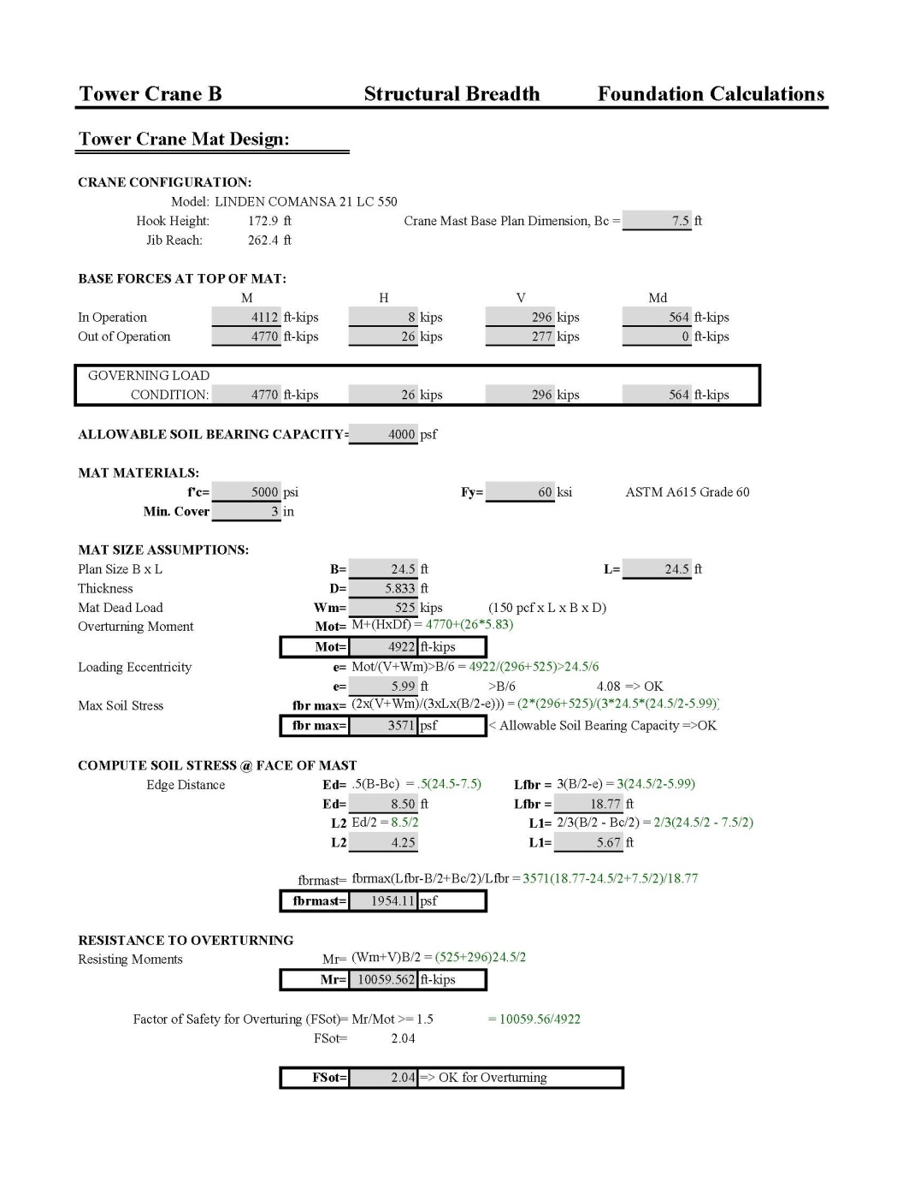
Appendix
Structural Breadth

Slide 27
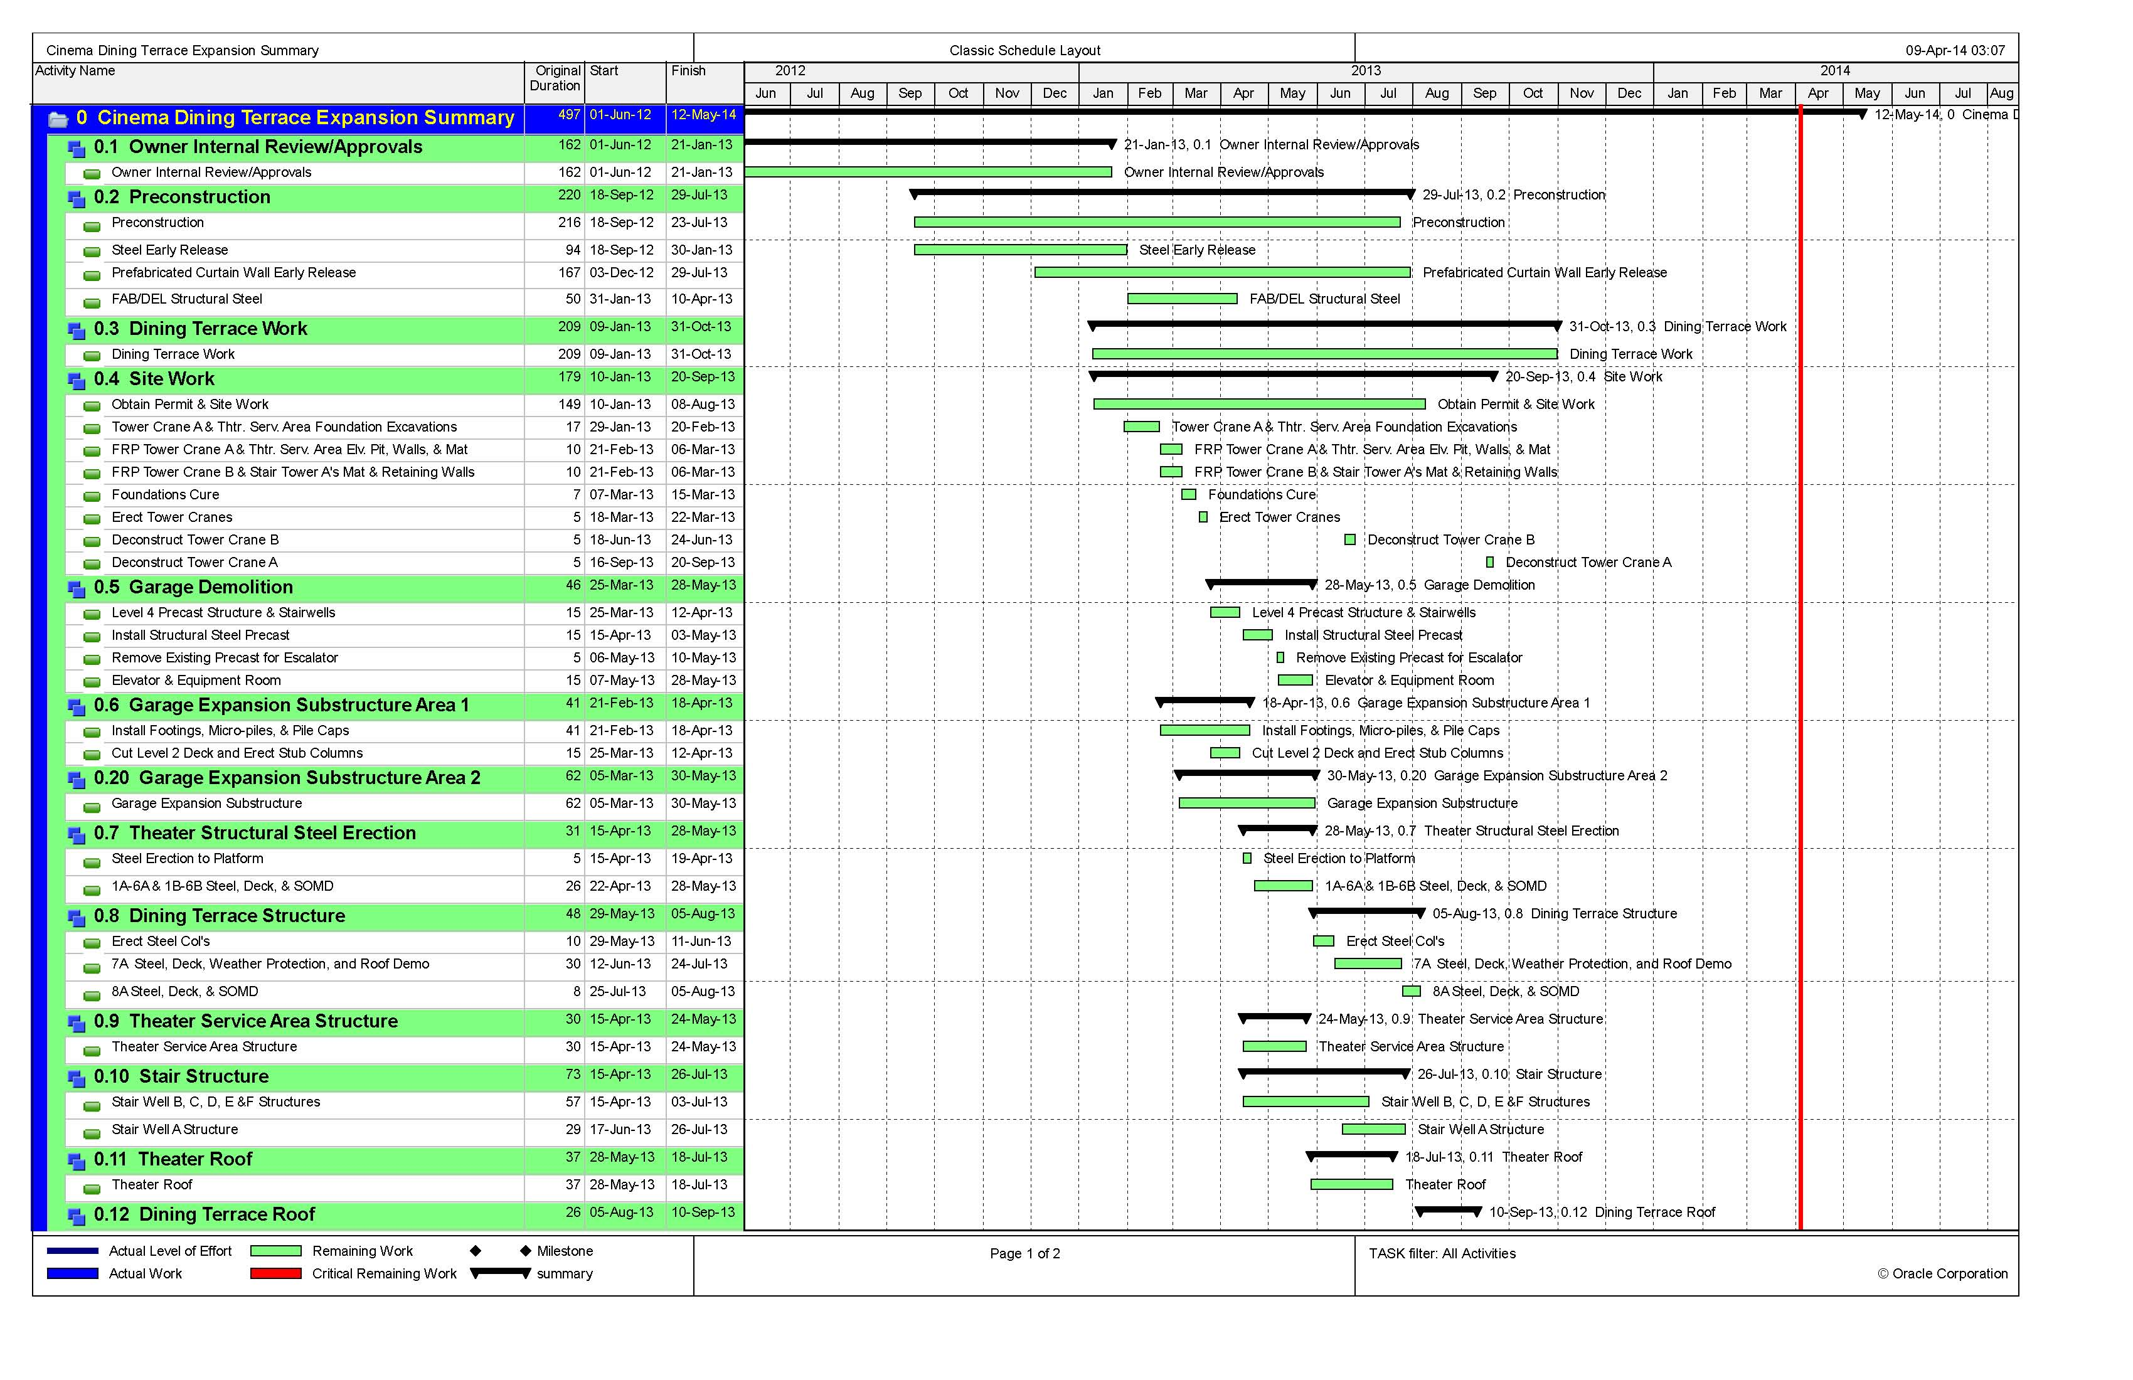
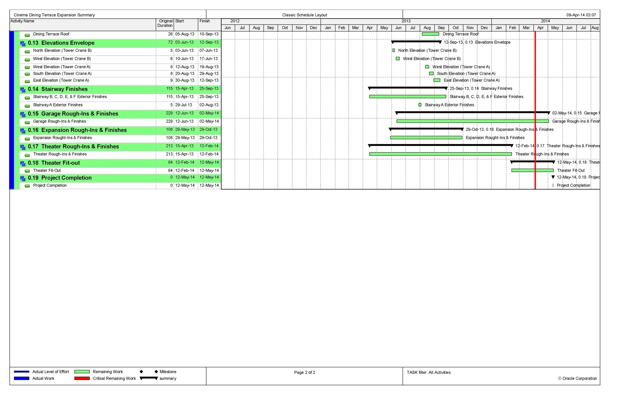
Appendix
New Project Schedule

